Slide 2
Objectives

Slide 3
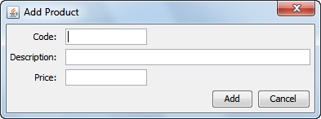
A window that contains labels and text fields
text fields
labels

Slide 4
The JLabel class

Slide 5
The JTextField class

Slide 6
How to create a text box for approximately 20 characters

Slide 7
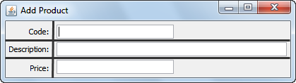
Six components in a grid

Slide 8
The package that contains the layout managers

Slide 9
Code that uses a GridBagConstraints object

Slide 10
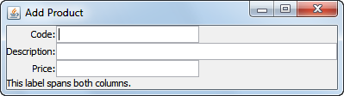
The resulting layout

Slide 11
More fields of the GridBagConstraints class

Slide 12
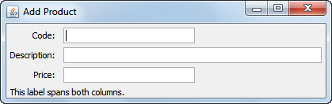
How to use insets to add padding

Slide 13
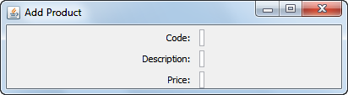
A common problem after horizontal resizing

Slide 14
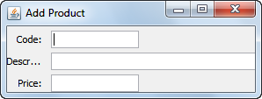
Code that sets the preferred and maximum sizes

Slide 15
Three ways to fix this problem

Slide 16
A JDialog constructor

Slide 17
A class for a custom dialog

Slide 18
A class for a custom dialog (cont.)

Slide 19

A statement that displays this dialog

Slide 20
How to set data in a dialog

Slide 21
A method of the Window class

Slide 22
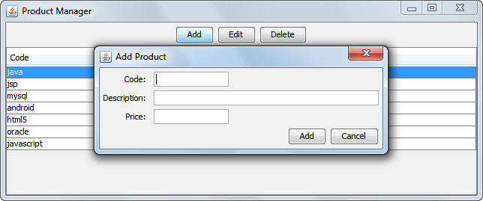
The Add Product dialog

Slide 23
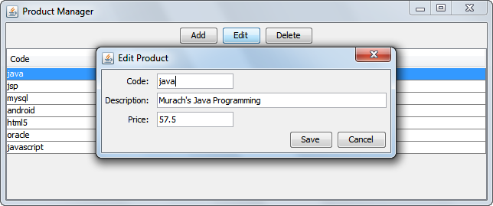
The Edit Product dialog

Slide 24
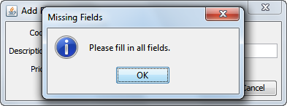
One of the data validation dialogs

Slide 25
The ProductForm class

Slide 26
The ProductForm class (cont.)

Slide 27
The ProductForm class (cont.)

Slide 28
The ProductForm class (cont.)

Slide 29
The ProductForm class (cont.)

Slide 30
The ProductForm class (cont.)

Slide 31
The ProductForm class (cont.)

Slide 32
The ProductForm class (cont.)

Slide 33
The ProductForm class (cont.)

Slide 34
The ProductForm class (cont.)

Slide 35
The ProductForm class (cont.)

Slide 36
The ProductForm class (cont.)

Slide 37
A method that uses the ProductForm class

Slide 38
Another method that uses the ProductForm class

Slide 39
May cause the GUI to become unresponsive

Slide 40
Keeps the GUI responsive but shouldn’t update it

Slide 41
Keeps the GUI responsive and can update it

