Slide 2
Objectives

Slide 3
Objectives (cont.)

Slide 4
Common Java GUI libraries

Slide 5
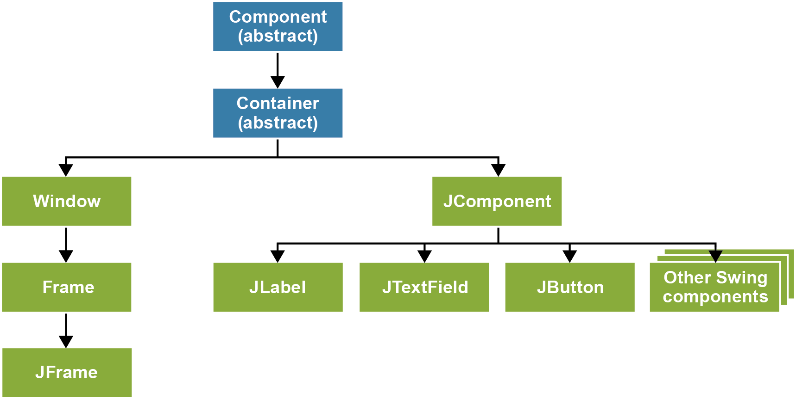
The Swing inheritance hierarchy

Slide 6
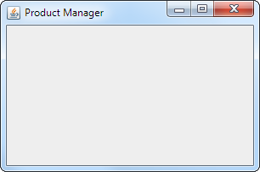
The package that contains the Swing classes

Slide 7
A main method that creates and displays a frame

Slide 8
A method of the JFrame and JPanel objects

Slide 9
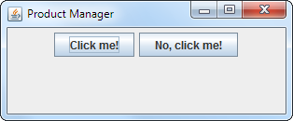
Two buttons in a panel

Slide 10
JButton object

Slide 11
The package that contains the events

Slide 12
Code that adds an event handler to a button

Slide 13
The package that contains the layout managers

Slide 14
A FlowLayout with four buttons

Slide 15
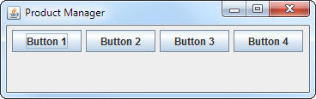
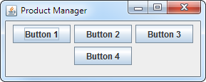
FlowLayout when all components fit on one line

Slide 16
A constructor of the FlowLayout class

Slide 17
A method of the BorderLayout class

Slide 18
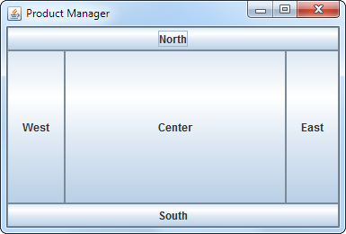
A JFrame using a BorderLayout

Slide 19
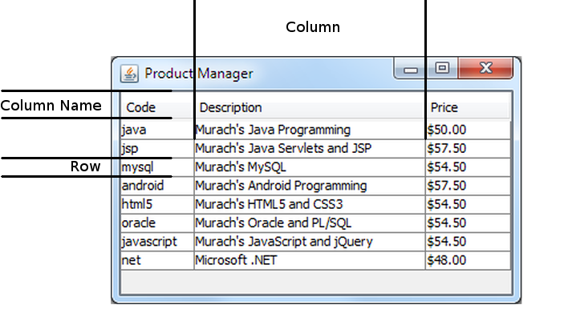
JTable terminology

Slide 20
AbstractTableModel

Slide 21
The ProductTableModel class

Slide 22
The ProductTableModel class (cont.)

Slide 23
The ProductTableModel class (cont.)

Slide 24
The ProductTableModel class (cont.)

Slide 25
The JTable class

Slide 26
ListSelectionModel values

Slide 27
Code that creates a table

Slide 28
To add a component to a scroll pane

Slide 29
The JScrollPane class

Slide 30
To make the scrollbars always visible

Slide 31
JOptionPane message types

Slide 32
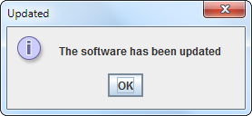
To display an information message

Slide 33
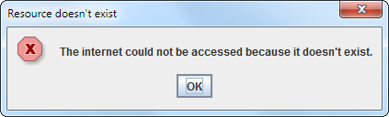
To display an error message

Slide 34
JOptionPane option types

Slide 35
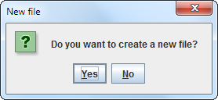
A question dialog with Yes and No buttons

Slide 36
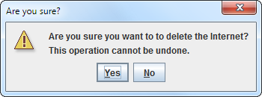
A question dialog with a warning icon

Slide 37
JOptionPane return values

Slide 38
How to determine which button was selected

Slide 39
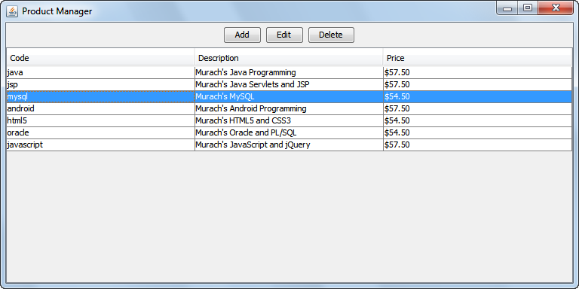
The Product Manager frame

Slide 40
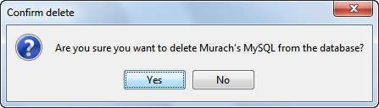
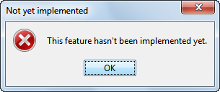
The dialog box for the Delete button

Slide 41
The ProductManagerFrame class

Slide 42
The ProductManagerFrame class (cont.)

Slide 43
The ProductManagerFrame class (cont.)

Slide 44
The ProductManagerFrame class (cont.)

Slide 45
The ProductManagerFrame class (cont.)

Slide 46
The ProductManagerFrame class (cont.)

Slide 47
The ProductManagerFrame class (cont.)

Slide 48
The ProductManagerFrame class (cont.)

