Slide 1
Chapter 13

Slide 2
Objectives

Slide 3
Objectives (cont.)

Slide 4
An introduction to inner classes

Slide 5
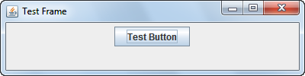
A GUI that displays a button

Slide 6
Three Swing classes to display a button

Slide 7
A class that uses an inner class

Slide 8
A class that uses an inner class (cont.)

Slide 9
A class that uses an anonymous class

Slide 10
Another way to use an anonymous class

Slide 11
The syntax for declaring an enumeration

Slide 12
A method that uses an enumeration as a parameter

Slide 13
Two methods of an enumeration constant

Slide 14
How to add a method to an enumeration

Slide 15
How to use an enumeration

Slide 16
How to code a static import statement

Slide 17
The Product class with javadoc comments

Slide 18
The Product class with javadoc comments (cont.)

Slide 19
Common HTML tags for javadoc comments

Slide 20
The Product class with javadoc tags

Slide 21
The Product class with javadoc tags (cont.)

Slide 22
The Product class with javadoc tags (cont.)

Slide 23
How to generate and view Javadoc
Jim's note:
I open the .java file in the editor
Then choose: Project->Generate Javadoc
Then chose: Window->Select View-> Javadoc
Then right-click in the Javadoc window and choose: Open Attached Javadoc (Shift F2)

Slide 24
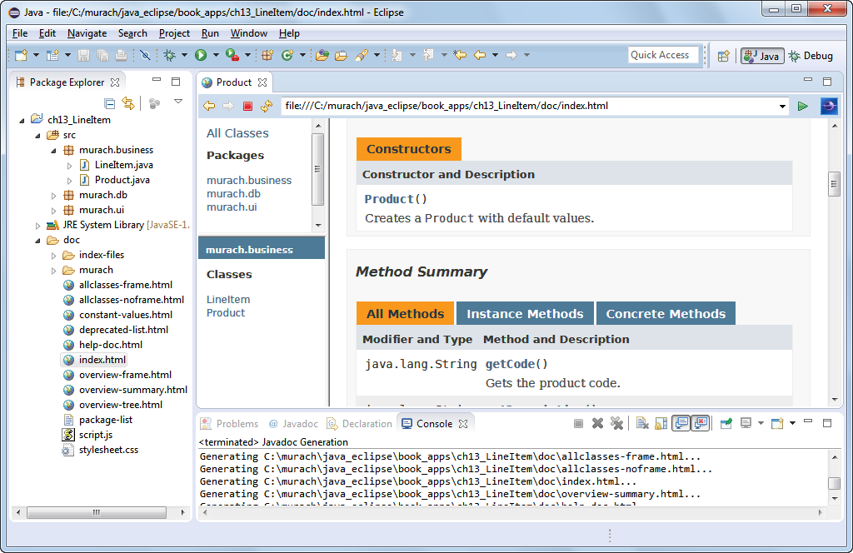
The API documentation that’s generated

