Slide 1
Chapter 6

Slide 2
Objectives

Slide 3
The Line Item application with a logic error

Slide 4
The goal of testing

Slide 5
Three test phases

Slide 6
Three types of errors that can occur

Slide 7
Code that contains errors

Slide 8
Common syntax errors

Slide 9
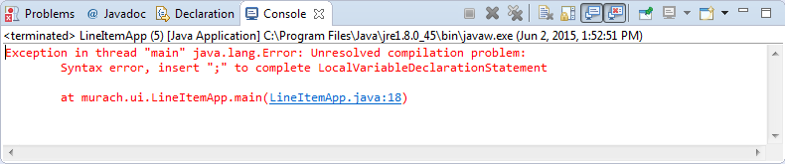
A compile-time error
A link to a line of code

Slide 10
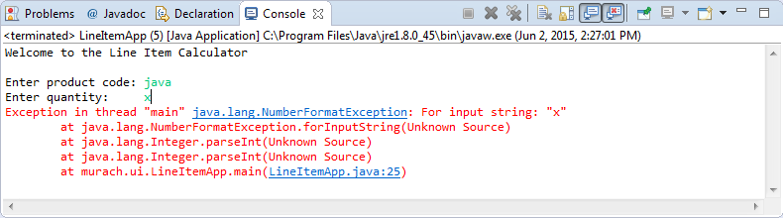
A runtime error
A link to a line of code

Slide 11
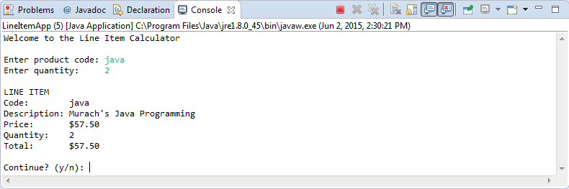
A logic error

Slide 12
Println statements that trace execution

Slide 13
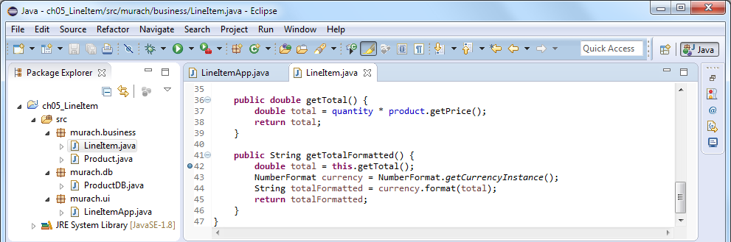
A code editor window with a breakpoint

Slide 14
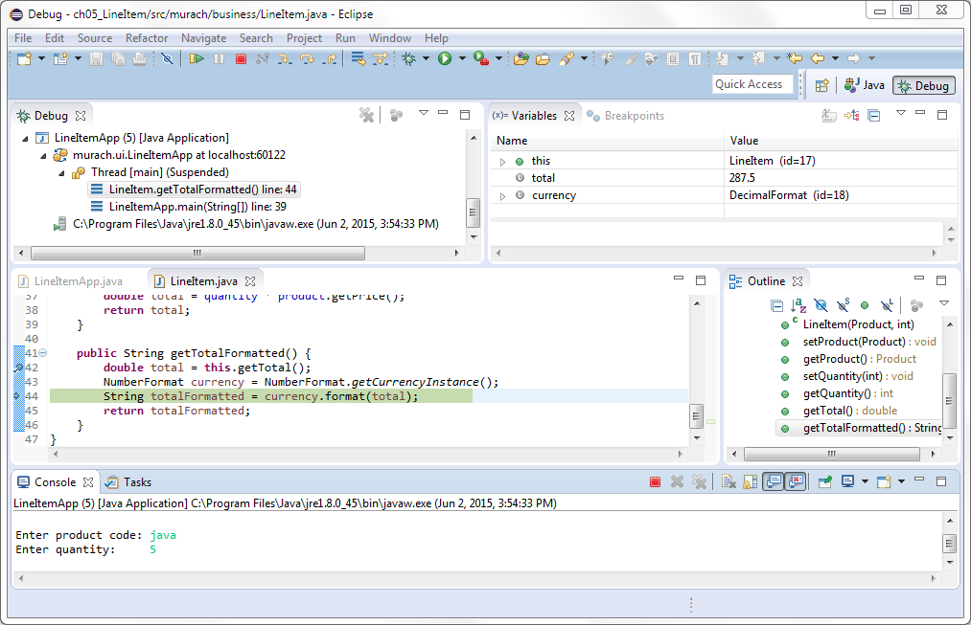
A debugging session

Slide 15
Debug buttons and shortcuts

Slide 16
The Call Stack window

