Slide 1
Chapter 5

Slide 2
Objectives

Slide 3
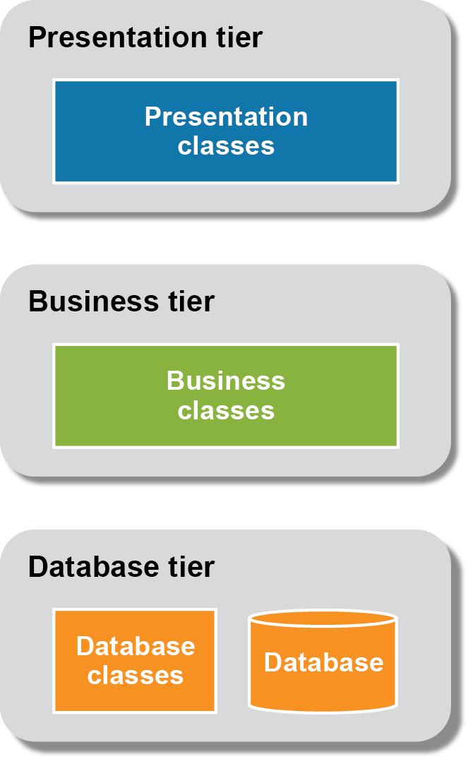
The three-tier architecture of an application

Slide 4
The folders and files for an application

Slide 5
The LineItem class

Slide 6
The LineItemApp class

Slide 7
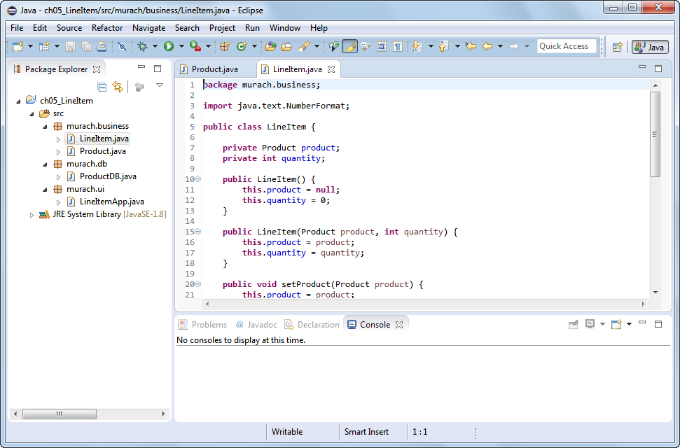
A project that contains multiple packages

Slide 8
The console

Slide 9
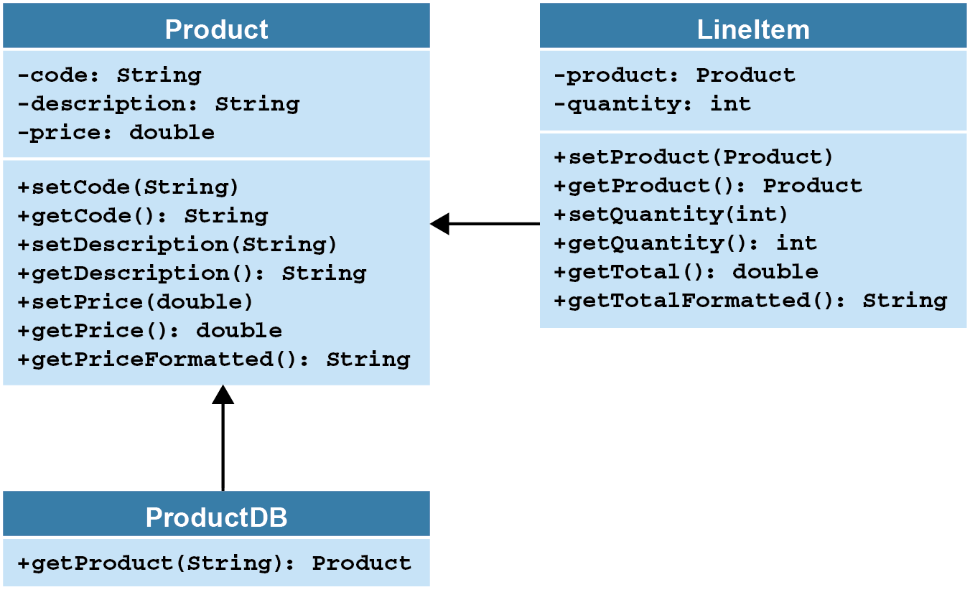
The class diagrams

Slide 10
The LineItem class

Slide 11
The LineItem class (cont.)

Slide 12
The LineItem class (cont.)

Slide 13
The LineItemApp class

Slide 14
The LineItemApp class (cont.)

Slide 15
The LineItemApp class (cont.)

