Slide 1
Chapter 4

Slide 2
Objectives

Slide 3
Objectives (cont.)

Slide 4
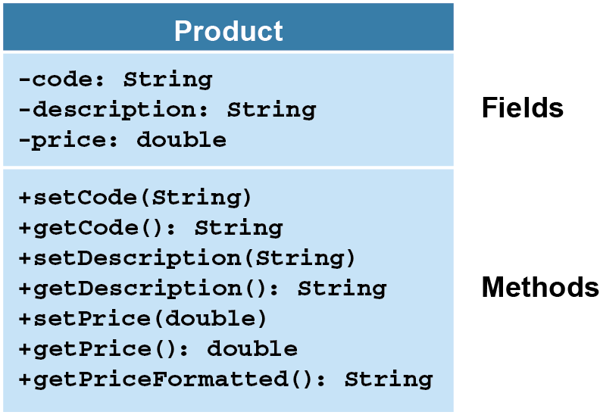
A class diagram for the Product class

Slide 5
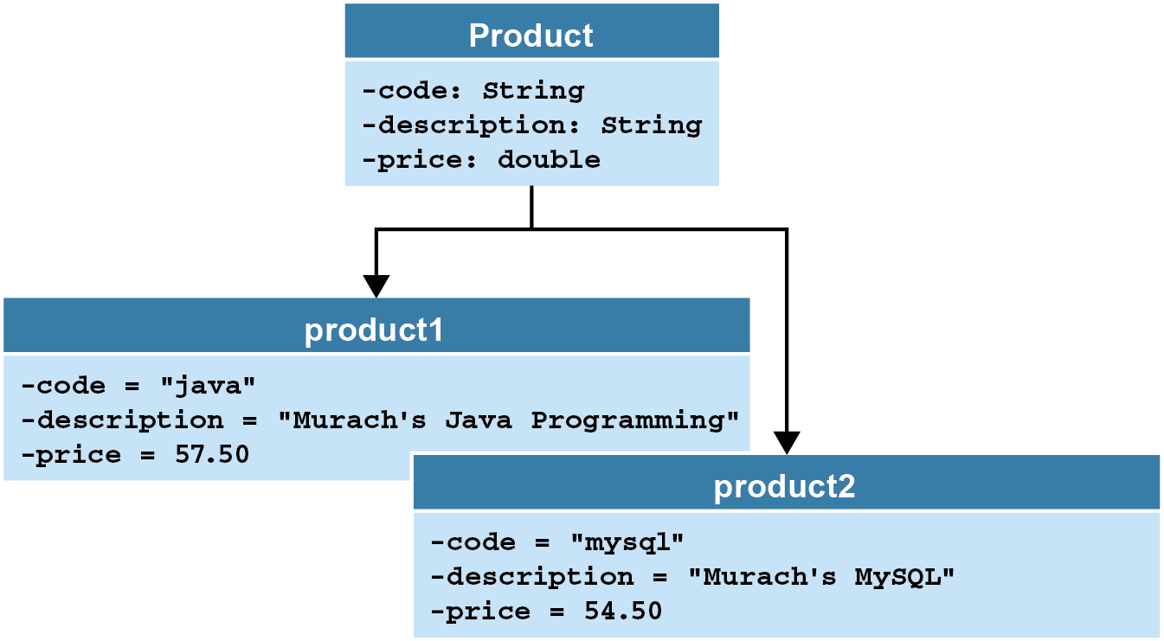
The relationship between a class and its objects

Slide 6
The code that’s generated for the Product class

Slide 7
The Product class

Slide 8
The Product class (cont.)

Slide 9
The Product class (cont.)

Slide 10
The syntax for declaring instance variables

Slide 11
Where you can declare instance variables

Slide 12
The syntax for coding constructors

Slide 13
A constructor with three parameters

Slide 14
The syntax for coding a method

Slide 15
A get method that returns a string

Slide 16
A set method

Slide 17
How to create an object in two statements

Slide 18
The syntax for calling a method

Slide 19
A statement that sends no arguments and returns a String object

Slide 20
The ProductDB class

Slide 21
The ProductDB class (cont.)

Slide 22
How to code static methods and fields

Slide 23
How to call static methods

Slide 24
The console

Slide 25
The ProductApp class

Slide 26
The ProductApp class (cont.)

Slide 27
How assignment statements work

Slide 28
How parameters work

Slide 29
How method calls work

Slide 30
A signature that has one parameter

Slide 31
Code that calls the printToConsole method

Slide 32
How to refer to instance variables of the current object

Slide 33
How to call a constructor of the current object

Slide 34
How to call a method of the current object

Slide 35
How to pass the current object to a method

Slide 36
The Product class with overloading

Slide 37
The Product class with overloading (cont.)

