Slide 1
Chapter 3

Slide 2
Objectives

Slide 3
Objectives

Slide 4
Objectives (cont.)

Slide 5
Common packages

Slide 6
The syntax of the import statement

Slide 7
How to create an object from a class

Slide 8
How to call a static method from a class

Slide 9
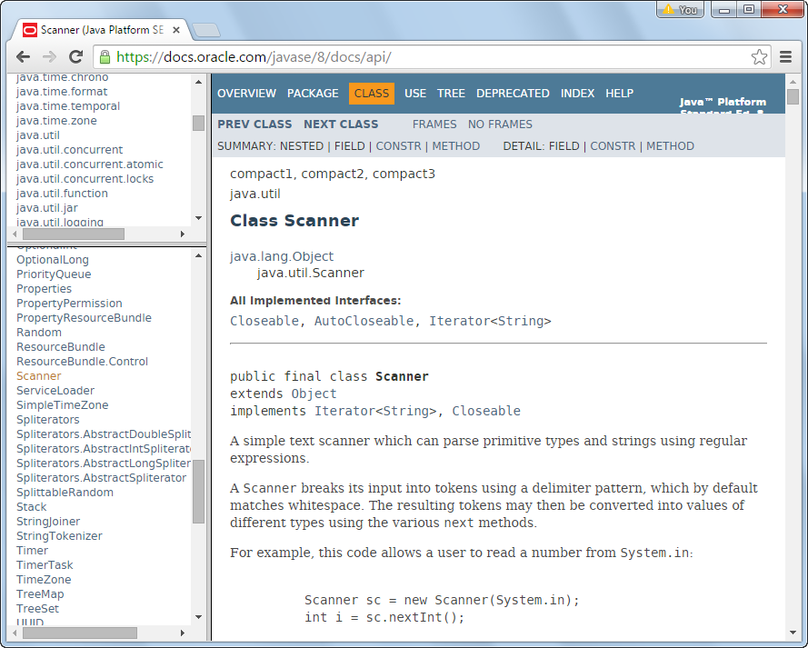
The documentation for the Scanner class

Slide 10
The Scanner class

Slide 11
How to get a String object for a product code

Slide 12
The Integer class

Slide 13
The Double class

Slide 14
A class that reads an entry from the console

Slide 15
How to get a double value from the user

Slide 16
The console if the user enters 49.50

Slide 17
The NumberFormat class

Slide 18
Three methods of a NumberFormat object

Slide 19
How to format a number as currency

Slide 20
How to format a number with one decimal place

Slide 21
A class that prints formatted output to the console

Slide 22
A class that prints formatted output to the console (cont.)

Slide 23
The console

Slide 24
Relational operators

Slide 25
Code that uses relational operators

Slide 26
Two methods of the String class

Slide 27
The syntax of the while loop

Slide 28
A loop that prints 1 through 4 to the console

Slide 29
The syntax of the if/else statement

Slide 30
Examples of if/else statements

Slide 31
Examples of if/else statements (cont.)

Slide 32
The console after two calculations (part 1)

Slide 33
The console after two calculations (part 2)

Slide 34
The code for the LineItem application

Slide 35
The code for the LineItem application (cont.)

Slide 36
The code for the LineItem application (cont.)

Slide 37
The console after two calculations

Slide 38
The Future Value application

Slide 39
The Future Value application (cont.)

Slide 40
The Future Value application (cont.)

Slide 41
The Future Value application (cont.)

