Slide 1
Chapter 2

Slide 2
Objectives

Slide 3
Objectives (cont.)

Slide 4
A class that has a main method

Slide 5
The folder and filename for this class

Slide 6
A class that includes statements and comments

Slide 7
Two methods of the System.out object

Slide 8
A class that prints output to the console

Slide 9
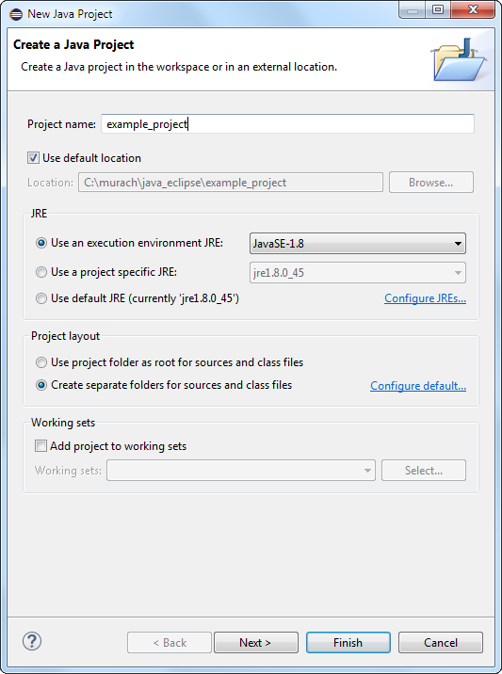
The first dialog box for creating a new project

Slide 10
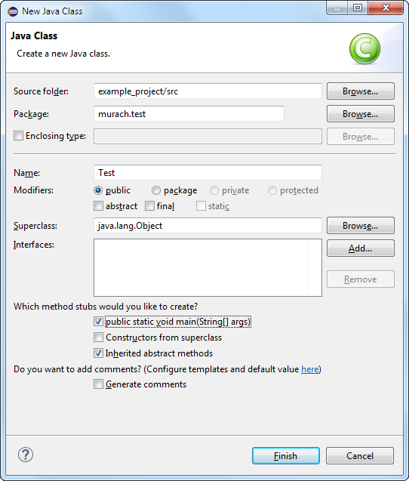
The second dialog box for creating a new project

Slide 11
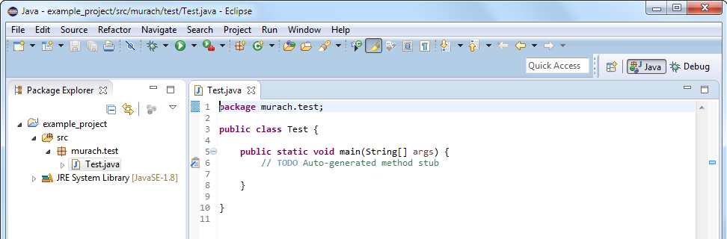
The starting source code for a project

Slide 12
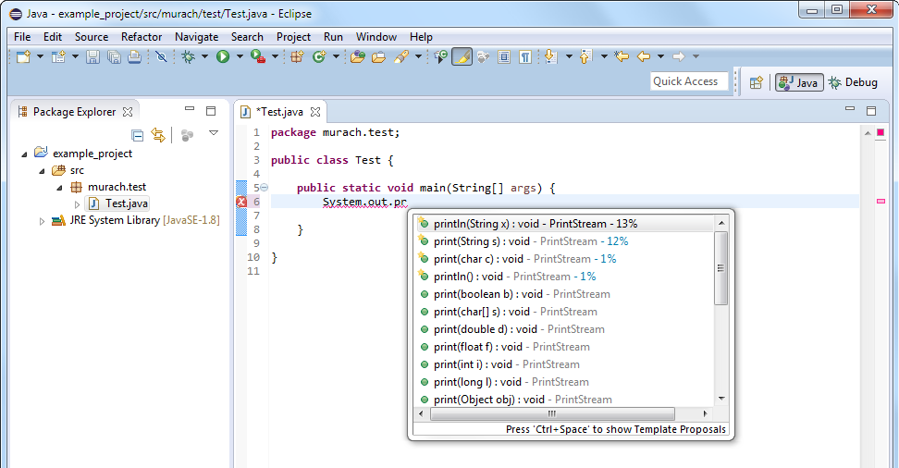
The code editor with a code completion list

Slide 13
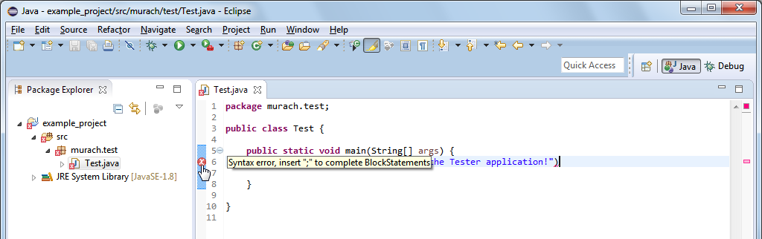
The code editor with an error displayed

Slide 14
Two of the eight primitive data types

Slide 15
How to declare and initialize a variable in two statements

Slide 16
How to declare and initialize a variable in one statement

Slide 17
Naming recommendations for variables

Slide 18
Java keywords

Slide 19
The syntax for an assignment statement

Slide 20
The basic arithmetic operators

Slide 21
Code that calculates a total amount

Slide 22
Code that divides two int values

Slide 23
How to declare and initialize a String variable

Slide 24
How to join strings

Slide 25
Common escape sequences

Slide 26
The new line character

Slide 27
The new line, return, and tab characters

Slide 28
A syntax error due to quotation marks

Slide 29
A syntax error due to backslashes

Slide 30
The Code Tester application

Slide 31
The CodeTesterApp class

Slide 32
The CodeTesterApp class (cont.)

