Slide 1
Chapter 1

Slide 2
Objectives

Slide 3
Java timeline

Slide 4
The Java Development Kit (JDK) includes…

Slide 5
Java editions

Slide 6
Operating systems that support Java

Slide 7
Java compared to C++

Slide 8
Java compared to C#

Slide 9
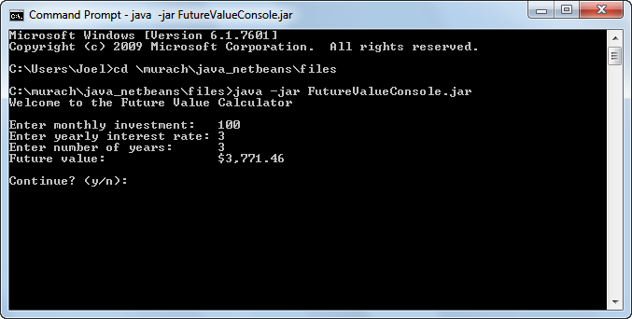
A console application

Slide 10
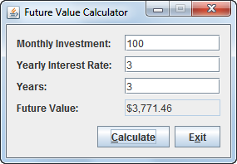
A GUI application

Slide 11
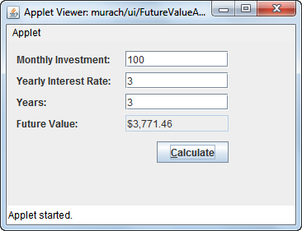
An applet

Slide 12
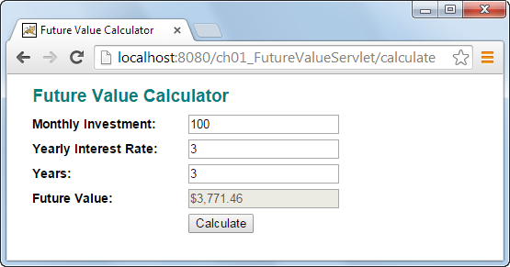
A servlet

Slide 13
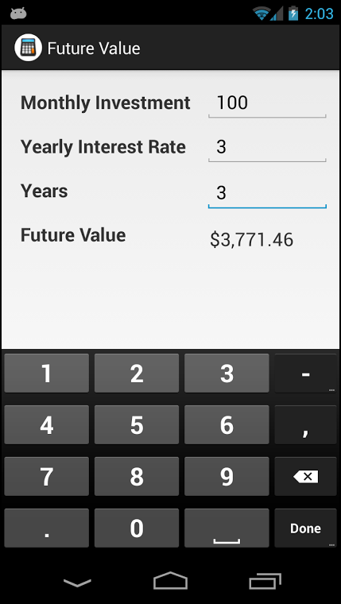
A mobile app

Slide 14
The code for a console application

Slide 15
The code for a console application (cont.)

Slide 16
The code for a console application (cont.)

Slide 17
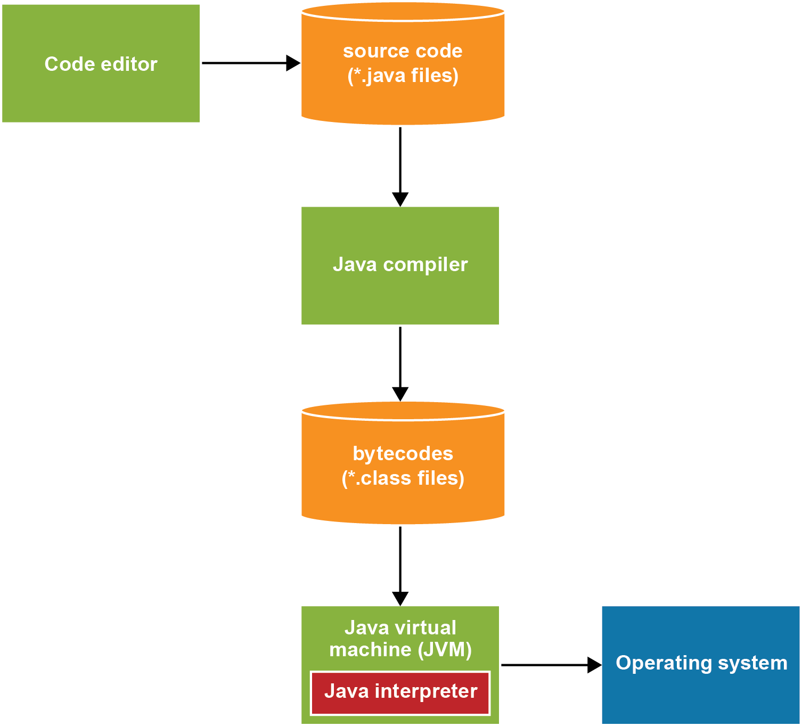
How Java compiles and interprets code

Slide 18
Popular Java IDEs

Slide 19
Features provided by most IDEs

Slide 20
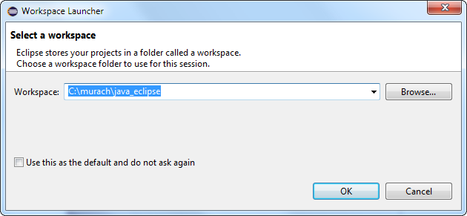
The dialog box for selecting a workspace

Slide 21
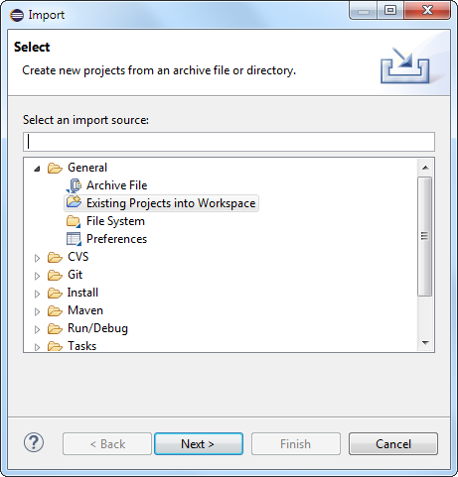
The first dialog box for importing a project

Slide 22
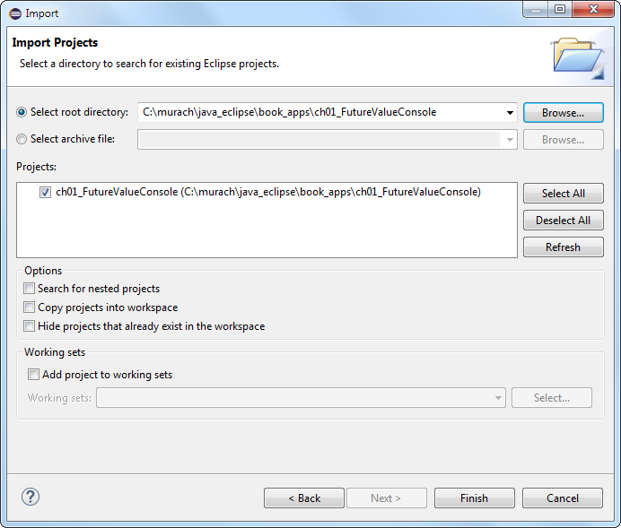
The second dialog box for importing a project

Slide 23
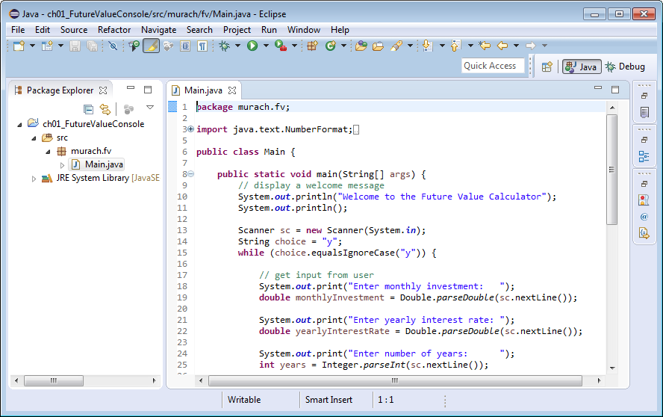
The Package Explorer and a code editor

Slide 24
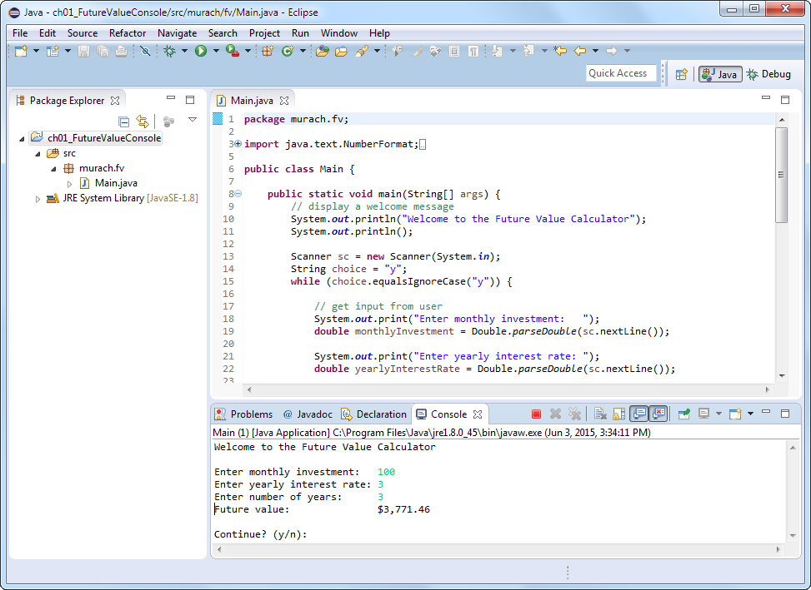
The Console window for input and output

Slide 25
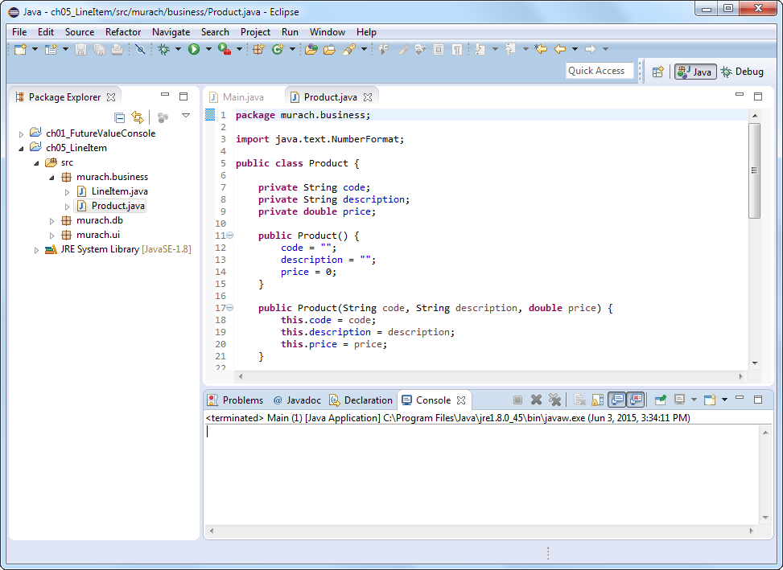
Two projects in the workspace

